Slide 1

Pennant Technologies Private Limited
SQL Joins in SQL

Slide 4
SQL Server JOINS
The join clause allows us to retrieve data from two or more related tables into a meaningful result set.
We can join the table using a SELECT statement and a join condition.
It indicates how SQL Server can use data from one table to select rows from another table.
In general, tables are related to each other using foreign key constraints.
In a JOIN query, a condition indicates how two tables are related:
Choose columns from each table that should be used in the join.
A join condition indicates a foreign key from one table and its corresponding key in the other table.
Specify the logical operator to compare values from the columns like =, <, or >.

Slide 5
Types of Joins
There are different types of joins available in SQL −
INNER JOIN − returns rows when there is a match in both tables.
LEFT JOIN − returns all rows from the left table, even if there are no matches in the right table.
RIGHT JOIN − returns all rows from the right table, even if there are no matches in the left table.
FULL JOIN − returns rows when there is a match in one of the tables.
SELF JOIN − is used to join a table to itself as if the table were two tables, temporarily renaming at least one table in the SQL statement.
CARTESIAN JOIN − returns the Cartesian product of the sets of records from the two or more joined tables.

Slide 6
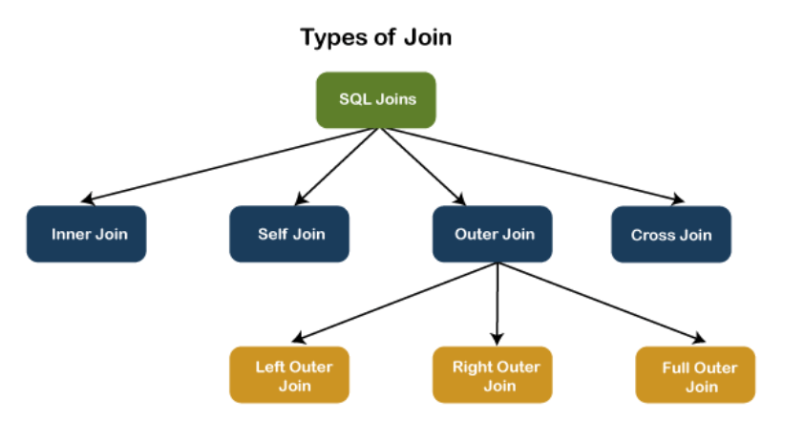

Slide 7
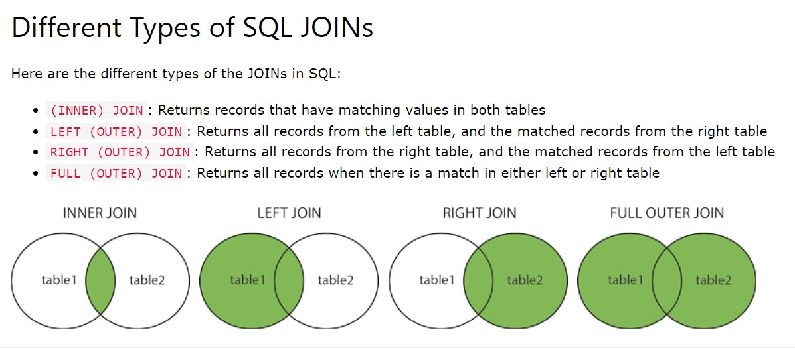

Slide 8
INNER JOIN
This JOIN returns all records from multiple tables that satisfy the specified join condition. It is the simple and most popular form of join and assumes as a default join. If we omit the INNER keyword with the JOIN query, we will get the same output.
INNER JOIN Syntax
The following syntax illustrates the use of INNER JOIN in SQL Server:
SELECT columns FROM table1
INNER JOIN table2 ON condition1
INNER JOIN table3 ON condition2

Slide 9
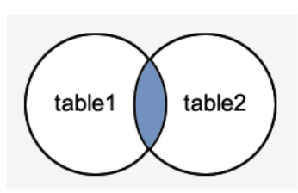
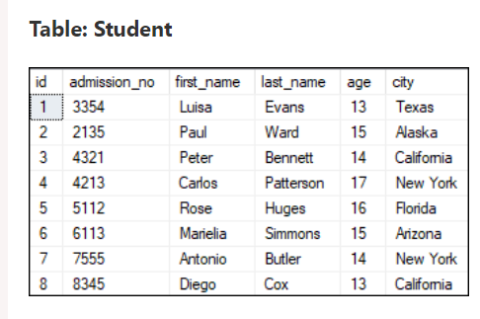
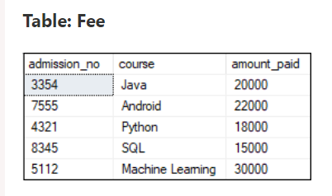

Slide 10
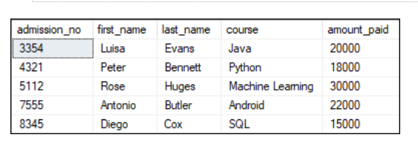
Inner Join Examples
We can demonstrate the INNER JOIN using the following command:
SELECT Student.admission_no, Student.first_name, Student.last_name, Fee.course, Fee.amount_paid
FROM Student INNER JOIN Fee
ON Student.admission_no = Fee.admission_no;
In this example, we have used the admission_no column as a join condition to get the data from both tables. Depending on this table, we can see the information of the students who have paid their fee.

Slide 11
SELF JOIN
A table is joined to itself using the SELF JOIN. It means that each table row is combined with itself and with every other table row.
The SELF JOIN can be thought of as a JOIN of two copies of the same tables.
We can do this with the help of table name aliases to assign a specific name to each table's instance.
The table aliases enable us to use the table's temporary name that we are going to use in the query.
It's a useful way to extract hierarchical data and comparing rows inside a single table.
SELF JOIN Syntax
The following expression illustrates the syntax of SELF JOIN in SQL Server. It works the same as the syntax of joining two different tables. Here, we use aliases names for tables because both the table name are the same.
SELECT T1.col_name, T2.col_name... FROM table1 T1, table1 T2 WHERE join_condition;

Slide 12
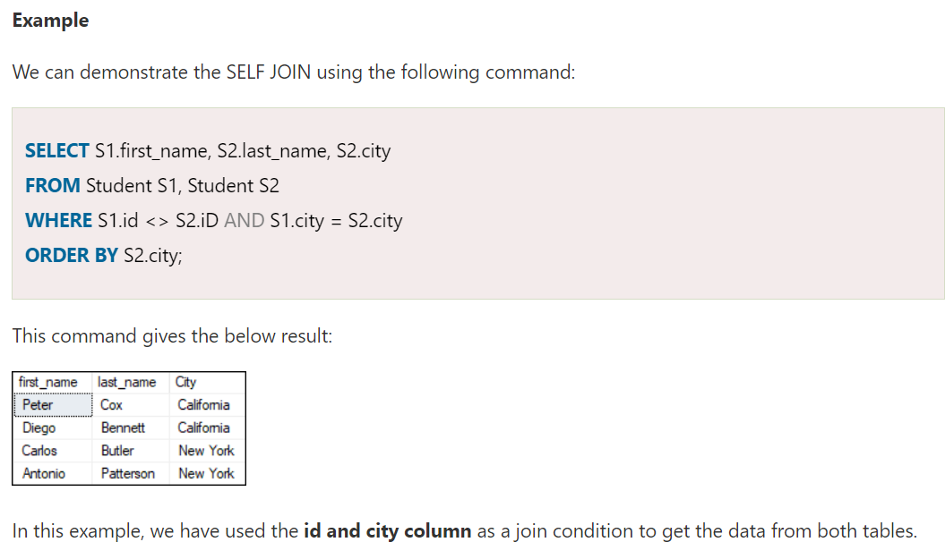

Slide 13
CROSS JOIN
CROSS JOIN in SQL Server combines all of the possibilities of two or more tables and returns a result that includes every row from all contributing tables.
It's also known as CARTESIAN JOIN because it produces the Cartesian product of all linked tables.
The Cartesian product represents all rows present in the first table multiplied by all rows present in the second table.
The below visual representation illustrates the CROSS JOIN. It will give all the records from table1 and table2 where each row is the combination of rows of both tables:
CROSS JOIN Syntax
The following syntax illustrates the use of CROSS JOIN in SQL Server:
SELECT column_lists FROM table1 CROSS JOIN table2;
Example
We can demonstrate the CROSS JOIN using the following command:
SELECT Student.admission_no, Student.first_name, Student.last_name, Fee.course, Fee.amount_paid
FROM Student CROSS JOIN Fee WHERE Student.admission_no = Fee.admission_no;

Slide 14
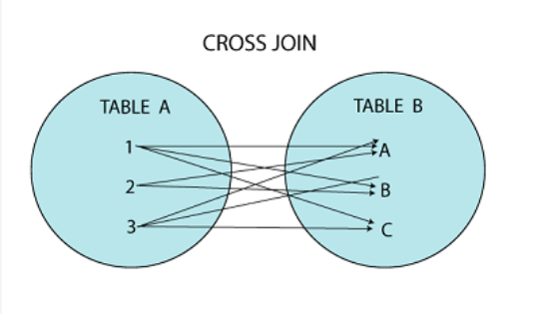
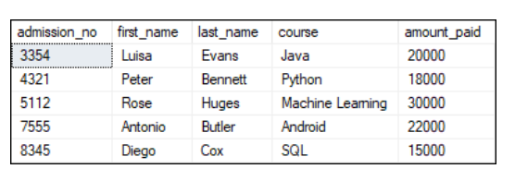

Slide 15
OUTER JOIN
OUTER JOIN in SQL Server returns all records from both tables that satisfy the join condition. In other words, this join will not return only the matching record but also return all unmatched rows from one or both tables.
We can categories the OUTER JOIN further into three types:
LEFT OUTER JOIN
RIGHT OUTER JOIN
FULL OUTER JOIN
LEFT OUTER JOIN
The LEFT OUTER JOIN retrieves all the records from the left table and matching rows from the right table. It will return NULL when no matching record is found in the right side table. Since OUTER is an optional keyword, it is also known as LEFT JOIN.
LEFT OUTER JOIN Syntax
The following syntax illustrates the use of LEFT OUTER JOIN in SQL Server:
SELECT column_lists FROM table1 LEFT [OUTER] JOIN table2 ON table1.column = table2.column;

Slide 16
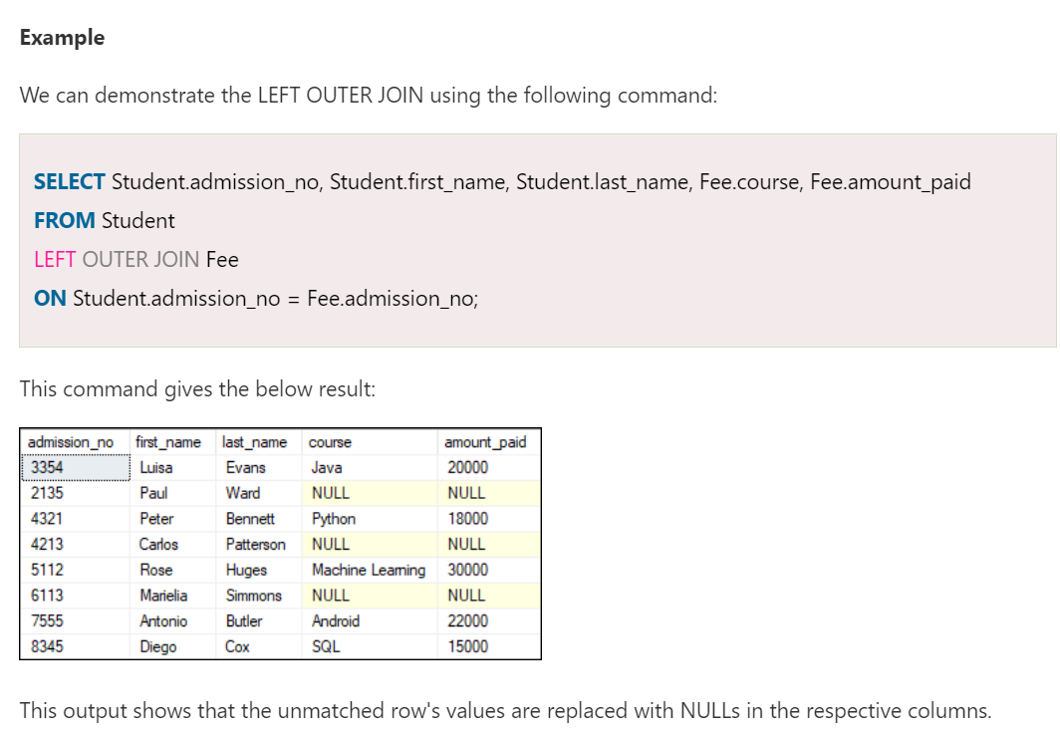
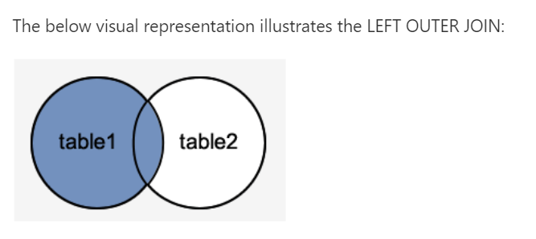

Slide 17
RIGHT OUTER JOIN
The RIGHT OUTER JOIN retrieves all the records from the right-hand table and matched rows from the left-hand table. It will return NULL when no matching record is found in the left-hand table. Since OUTER is an optional keyword, it is also known as RIGHT JOIN.
RIGHT OUTER JOIN Syntax
The following syntax illustrates the use of RIGHT OUTER JOIN in SQL Server:
SELECT column_lists FROM table1 RIGHT [OUTER] JOIN table2 ON table1.column = table2.column;
Example
The following example explains how to use the RIGHT OUTER JOIN to get records from both tables:
SELECT Student.admission_no, Student.first_name, Student.last_name, Fee.course, Fee.amount_paid FROM Student RIGHT OUTER JOIN Fee ON Student.admission_no = Fee.admission_no;

Slide 18
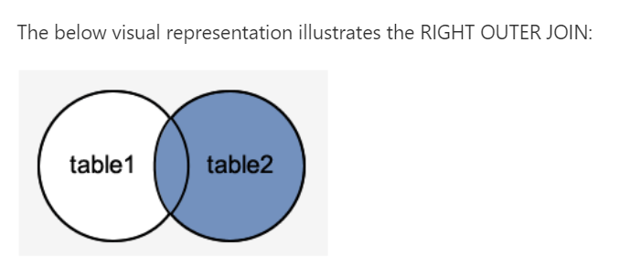
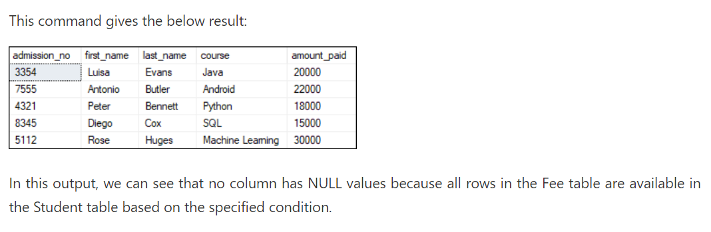

Slide 19
FULL OUTER JOIN
The FULL OUTER JOIN in SQL Server returns a result that includes all rows from both tables.
The columns of the right-hand table return NULL when no matching records are found in the left-hand table.
And if no matching records are found in the right-hand table, the left-hand table column returns NULL.
FULL OUTER JOIN Syntax
The following syntax illustrates the use of FULL OUTER JOIN in SQL Server:
SELECT column_lists FROM table1 FULL [OUTER] JOIN table2 ON table1.column = table2.column;
Example The following example explains how to use the FULL OUTER JOIN to get records from both tables:
SELECT Student.admission_no, Student.first_name, Student.last_name, Fee.course, Fee.amount_paid FROM Student FULL OUTER JOIN Fee ON Student.admission_no = Fee.admission_no;

Slide 20
